Slide 1
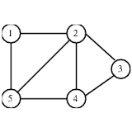
Chapter 13 Part 1

Slide 2
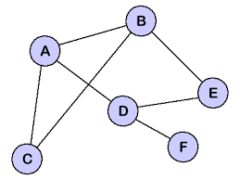
Chapter 13 Part 1 : Graphs
Graph ADT: Operations
Graph Implementation: Data structures
Graph Traversals: DFS

Slide 3
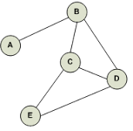
Graphs
A graph is a way of representing relationships that exist between pairs of objects
A graph is a pair (V, E) where
A set of objects V
Vertices
A collection E of pairs of vertices from V
Edges
Vertices are positions and store elements
Edges are positions
Directed or undirected

Slide 4
Graph
Collection of vertices and edges stored at positions

Slide 5
Modeling Using Graphs
The problem of finding the shortest distance between two cities can be modeled using a graph where one measures the distance between two vertices (cities)

Slide 6
Graph Example
A vertex represents an airport and stores the three-letter airport code
An edge represents a flight route between two airports and stores the mileage of the route
849
PVD
1843
ORD
142
SFO
802
LGA
337
1743
1387
HNL
2555
1099
LAX
1233
DFW
1120
MIA

Slide 7
Applications
Electronic circuits
Printed circuit board
Integrated circuit
Transportation networks
Highway network
Flight network
Computer networks
Local area network
Internet
Web
Databases
Entity-relationship diagram
cslab1a
cslab1b
math.saddleback.edu
cs.saddleback.edu
saddleback.edu
qwest.net
att.net
cox.net
Jerry
Eric
Michelle

Slide 8
Basic Graph Terminology
Graph Theory – the study of graphs
Graph – A mathematical structure that represents relationships among entities in the real world
It consists of a non-empty set of vertices, nodes or points and a set of edges that connect the vertices
It is defined as G = (V,E) where V represents the set of vertices and E represents the set of edge
For example V = {“Seattle”, “San Francisco”, “Los Angeles”, …) and E = {{ “Seattle”,”San Francisco”}, {{ “Seattle”,”Chicago”}, {{ “Seattle”,”Denver”}, …}

Slide 9
Edge Types (1)
Directed edge
ordered pair of vertices (u,v)
first vertex u is the origin
second vertex v is the destination
e.g., a flight
Directed graph
all the edges are directed
e.g., route network
ORD
flight
AA 1206
PVD
ORD
PVD
ATL

Slide 10
Edge Types (2)
Undirected edge
unordered pair of vertices (u,v)
Move both direction between vertices
e.g., a flight route
Undirected graph
all the edges are undirected
e.g., flight network
ORD
PVD
849
miles
ORD
PVD
ATL

Slide 11
Weighted Graphs
In a weighted graph, each edge has an associated numerical value, called the weight of the edge
Edge weights may represent distances, costs, etc.
Example:
In a flight route graph, the weight of an edge represents the distance in miles between the endpoint airports
849
PVD
1843
ORD
142
SFO
802
LGA
1743
1205
337
1387
HNL
2555
1099
LAX
1233
DFW
1120
MIA

Slide 12
Basic Graph Terminology
Graph Theory – the study of graphs
Graph – A mathematical structure that represents relationships among entities in the real world
It consists of a non-empty set of vertices, nodes or points and a set of edges that connect the vertices
It is defined as G = (V,E) where V represents the set of vertices and E represents the set of edge
For example V = {“Seattle”, “San Francisco”, “Los Angeles”, …) and E = {{ “Seattle”,” San Francisco”}, {{ “Seattle”,” Chicago”}, {{ “Seattle”,” Denver”}, …}

Slide 13
Vertices
End vertices (or endpoints) of an edge
Two vertices joined by an edge
U and V are the endpoints
If an edge is directed
Its first endpoint is call its origin (Y)
The other is the destination (X) of the edge
V
a
b
h
j
U
d
X
Z
c
e
i
W
g
f
Y

Slide 14
Adjacent Vertices and Edges
Vertices U and V are adjacent if there is an edge whose end vertices are U and V
Edges a and b are adjacent if they are connected to the same vertex
Two vertices are called neighbors if they are adjacent
Two edges are called neighbors if they are adjacent
V
a
b
U
d
X
c
e
W
g
f
Y

Slide 15
Incident Edges, Degree, and Loops
An edge that joins two vertices is said to be incident to both vertices
a is incident to both U and V
Degree of a vertex V, deg(V)
Number of incident edges of V
X has degree 5
Loop
Edge that connects a vertex to itself
j is a loop
V
a
b
h
U
d
X
Z
j
c
e
i
W
g
f
Y

Slide 16
Edges and Degrees
The outgoing edges of a vertex are the directed edges whose origin is that vertex
f is an outgoing edge of Y
The incoming edges of a vertex are the directed edges whose destination is that vertex
f is an incoming edge of W
In-degree of a vertex V is the number of incoming edges
indeg(W) is 1
Out-degree of a vertex V is the number of outgoing edges
outdeg(Y) is 1
V
a
b
h
U
d
X
Z
j
c
e
i
W
g
f
Y

Slide 17
Parallel Edges and Simple Graphs
Collection
Group of edges
Parallel edges
Two undirected edges that have the same end vertices
To directed edges that have the same origin and destination
h and i are parallel edges
Self-loop
Edge that connects a vertex to itself
j is a self-loop
A graph is simple if it does not have parallel edges or self-loops
V
a
b
h
U
d
X
Z
j
c
e
i
W
g
f
Y

Slide 18
Property 1
Property 1
Σ_{v} deg(v) = 2m
Proof: each edge is counted twice
3+3+3+3=12=2*6
Notation
m number of edges
deg(v) degree of vertex v
Example
m = 6
deg(v) = 3

Slide 19
Property 2
Property 2
Σ_{v} indeg(v) = Σ_{v} outdeg(v) = m
Proof: each edge contributes one unit to the in-degree and one unit to the out-degree
Notation
m number of edges
Example
m = 6
Σ_{v} indeg(v) = Σ_{v} outdeg(v) = 6

Slide 20
Property 3
Property 3
In an undirected graph with no self-loops and no parallel edges
m ≤ n (n − 1)/2
Proof: each vertex has degree at most (n − 1)
6 ≤ 4 (4 - 1)/2
Notation
n number of vertices
m number of edges
deg(v) degree of vertex v
Example
n = 4
m = 6

Slide 21
Paths
Path
Sequence of alternating vertices and edges
Begins with a vertex
Ends with a vertex
Each edge is preceded and followed by its endpoints
Simple path
Path such that all its vertices and edges are distinct
Examples
P₁=(V,b,X,h,Z) is a simple path
P₂=(U,c,W,e,X,g,Y,f,W,d,V) is a path that is not simple
Directed path
All edges are directed
Traversed along their direction
P₁
V
a
b
d
U
X
Z
h
c
e
W
g
P₂
f
Y

Slide 22
Cycles
Cycle
Circular sequence of alternating vertices and edges
Each edge is preceded and followed by its endpoints
Simple cycle
Cycle such that all its vertices and edges are distinct
Examples
C1=(V,b,X,g,Y,f,W,c,U,a,↵) is a simple cycle
C2=(U,c,W,e,X,g,Y,f,W,d,V,a,↵) is a cycle that is not simple
V
a
b
d
U
X
Z
h
e
c
C₁
W
g
f
C₂
Y

Slide 23
Directed Cycles and Paths
Directed cycle
All edges are directed
Traversed along their direction
Directed path
All edges are directed
Traversed along their direction
Each edge is preceded and followed by its endpoints

Slide 24
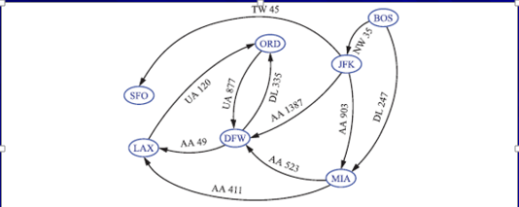
Directed Graph
Figure 13.2

Slide 25
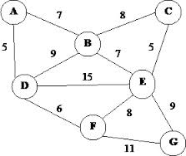
Graph ADT (Undirected)
A graph is a collection of elements that are stored at positions
Graph ADT defines two types of positions
Vertices and edges
Provides two list types of vertices and edge
VertexList and Edgelist

Slide 26
Graph ADT (Vertex Related) Methods
Each vertex object supports the following operations
v.operator*()
Returns the element associated with vertex v
*v: references the element associated with vertex v
*v.incidentEdges()
Returns an edge list of all the edges incident to vertex v
v.isAdjacentTo(u)
True if and only if vertices u and v are adjacent

Slide 27
Edge Related Accessor Methods of the Graph ADT
Each edge object supports the following operations
e.operator*()
Returns the element associated with edge e
*e: references the element associated with edge e
e.endVertices()
Returns an array of the two end vertices of edge
e.opposite(v)
Returns the vertex opposite of v on edge e
e.isAdjacentTo(f)
True if and only if edges e and f are adjacent
e.isIncidentTo(v)
Test whether edge e is incident to vertex v

Slide 28
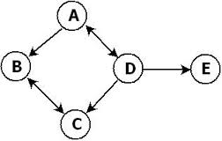
Other Graph ADT Methods - 1
insertVertex(x)
Insert and return a new vertex storing element x
insertEdge(v, w, x)
Insert and return a new undirected edge with end vertices v and w and storing element x
eraseVertex(v)
Remove vertex v and all its incident edges

Slide 29
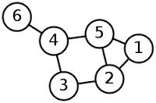
Other Graph ADT Methods - 2
eraseEdge(e)
Remove edge e
vertices()
Return a vertex list of all the vertices of the graph
edges()
Return an edge list of all the edges of the graph

Slide 30
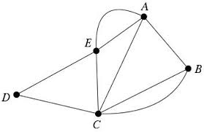
Graphs Data Structures Options - 1
Edge list structure
Adjacency list structure
Adjacency matrix

Slide 31
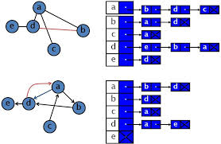
Graphs Data Structures Options - 2
All three use a collection to store the vertices
Edge and adjacency lists store the edges present in the graph
Adjacency matrix stores a placeholder for every pair of vertices irrespective if there is an edge between them

Slide 32
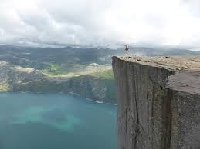
Edge List Structures (1)
Simplest and most common but not the most efficient
Provides direct access from the edges to the vertices they are incident upon
A vertex, v, storing an element x is represented by a vertex object
All vertices are stored in a collection V (an array or node list)

Slide 33
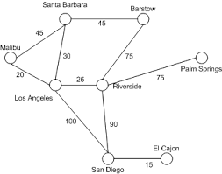
Edge List Structures (2)
An edge, e, storing an element x is represented by a edge object
All edges are stored in a collection E (an array or node list)
One can implement the collections V (vertices) and/or E (edges) with a dictionary

Slide 34
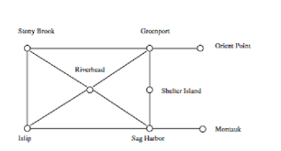
Representing Vertices (1)
Vertices can be stored in an array
For example:
String [ ] vertices = {“Seattle”, “San Francisco”, “Los Angeles”, “Denver”, “Kansas City”, ”Chicago”, “Boston”, “New York”, “Atlanta”, “Miami”, “Dallas”, “Houston”}
vertices [0] = Seattle;
vertices [1] = San Francisco;
vertices [2] = Los Angeles;
vertices [3] = Denver;
… vertices [11] = Houston;

Slide 35
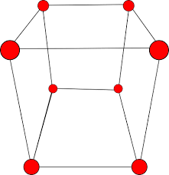
Representing Vertices (2)
Vertices can be referenced by its name or index
Vertices can be objects of any type

Slide 36
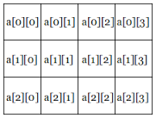
Representing Edges: Edge List
Edges are stored in a two dimensional array
For example
int [ ] edges ={ {0,1}, {0,3}, {0,5} … }
Where i and j are the indices of the vertices
e.g. Seattle and San Francisco, Seattle and Denver, Seattle and Chicago

Slide 37
Edge List Structure
u
Vertex objects storing element x have instance variables
Reference to x
Reference to the entry of the vertex-object in collection V
Edge object storing element x have instance variables
Reference to x
Reference to the vertex objects associated with the endpoint vertices
Reference to the entry of the edge-object in collection E
a
c
b
d
v
w
z
Graph
Vertices
u
v
w
z
a
b
c
d
Figure 13.3
Edges

Slide 38
Asymptotic Performance
n vertices, m edges no parallel edges no self-loops | Edge List
vertices | O(n)
edges | O(m)
endVertices, opposite | O(1)
v.incidentEdges() | O(m)
v.isAdjacentTo(w) | O(m)
isIncidentOn | O(1)
insertVertice, insertEdge, eraseEdge | O(1)
eraseVertex(V) | O(m)

Slide 39
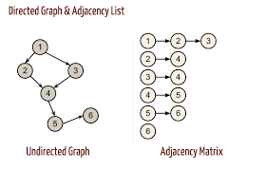
Adjacency List Structures
Extends the edge list structure
Provides direct access both from the edges to the vertices and from the vertices to their incident edges

Slide 40
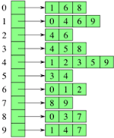
Representing Edges: Adjacency Lists (1)
Another way to represent edges
To represent edges using an Adjacency list, one defines an array of linked lists
The array has n entries where each entry represents a vertex
The linked list for vertex i contains all the vertices j such that there is an edge from vertex i to vertex j

Slide 41
Representing Edges: Adjacency Lists (2)
Seattle
1
3
5
San Francisco
0
2
3

Slide 42
Adjacency List Structure
a
v
b
u
w
Vertex objects v hold a reference to a collection I(v), the incidence collection of v, whose elements store references to the edges incident of v
Edge objects with vertices v and w hold references to the entries associated with I(v) and I(w)
Graph
Vertices
u
v
w
I(u)
I(v)
I(w)
a
b
Edges
Figure 13.4

Slide 43
Asymptotic Performance
n vertices, m edges no parallel edges no self-loops | Adjacency List
vertices | O(n)
edges | O(m)
endVertices, opposite | O(1)
v.incidentEdges() | O(deg(v))
v.isAdjacentTo(w) | O(min (deg(v), deg(w))
isIncidentOn | O(1)
insertVertice, insertEdge, eraseEdge | O(1)
eraseVertex(V) | O(deg(v))

Slide 44
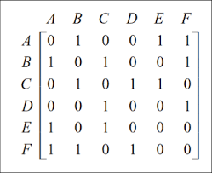
Adjacency Matrix Structures
Extends the edge list structure by augmenting with a matrix (two dimensional array) that allows one to determine adjacencies between pairs of vertices in constant time
Vertices are considered integers in the set {0,1,…,n-1} and the edges as being pairs of such integers

Slide 45
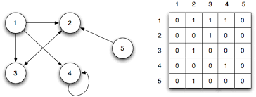
Representing Edges: Adjacency Matrices (1)
Another way to represent edges
Assume that a graph has n vertices, one can use a two-dimensional n x n array (adjacencyMatrix) to represent the edges where each element in the array is either a 0 or a 1
adjacencyMatrix[i][j] is 1 if there is a an edge from vertex i to vertex j other it is 0

Slide 46
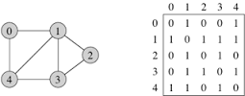
Representing Edges: Adjacency Matrices (2)
If the graph is undirected, the matrix will be symmetrical because adjacencyMatrix[i][j] is the same as adjacencyMatrix[j][i]
int [ ] adjacencyMatrix ={ {0,1,0,1,0,1,0,0,0,0,0,0}, // Seattle …
Since there are edges between Seattle and San Francisco, Denver, and Chicago

Slide 47
Adjacency Matrix Structure
A vertex object v stores a distinct integer, i in the range 0,1,2,..n-1
A two dimensional nxn array where the cell A[i,j] holds a reference to the edge (v,w), if it exists, where v is the vertex with index i and w is the vertex with index j
A[i,j] = null if the edge does not exist
a
v
b
u
Graph
w
Vertices
0
u
1
v
2
w
 | 0 | 1 | 2
0 | ∅ |  | ∅
1 |  | ∅
2 | ∅ |  | ∅
a
b
Figure 13.5
Edges

Slide 48
Asymptotic Performance
n vertices, m edges no parallel edges no self-loops | Adjacency Matrix
vertices | O(n)
edges | O(n²)
endVertices, opposite | O(1)
v.incidentEdges() | O(n)
v.isAdjacentTo(w) | O(1)
isIncidentOn | O(n)
insertEdge, eraseEdge | O(1)
insertVertice,eraseVertex(V) | O(n²)

Slide 49
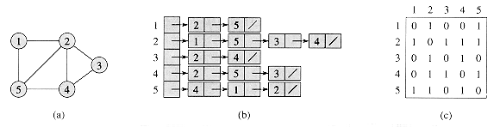
Adjacency Matrices vs. Adjacency Lists
If the graph is dense (lots of edges), adjacency matrix are more efficient
If the graph is sparse (few edges), adjacency lists are more efficient
It takes O(1) time to check whether two vertices are connected using a adjacency matrix
It takes O(n) time to print all the edges using an adjacency list where n is the number of edges

Slide 50
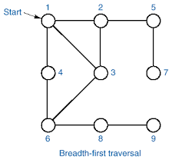
Graph Traversals
Systematic procedure for exploring a graph by examining all of its vertices and edges
Process of visiting each vertex in the graph exactly once
Two common methods
Depth-first traversal (depth-first search)
Breadth-first traversal (breadth-first search)

Slide 51
Subgraphs
A subgraph S of a graph G is a graph such that
The vertices of S are a subset of the vertices of G
The edges of S are a subset of the edges of G
A spanning subgraph of G is a subgraph that contains all the vertices of G
Subgraph
Spanning subgraph

Slide 52
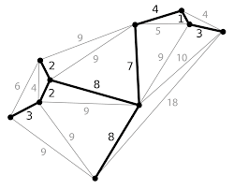
Graph Traversals
Both the depth-first and the breadth-first traversals result in a spanning tree

Slide 53
Connectivity
A graph is connected if there is a path between every pair of vertices
A connected component of a graph G is a maximal connected subgraph of G
Connected graph
Non-connected graph with two connected components

Slide 54
Trees and Forests
A (free) tree is an undirected graph T such that
T is connected
T has no cycles
Note: This definition of tree is different from the one of a rooted tree
A forest is an undirected graph without cycles
The connected components of a forest are trees
Tree
Forest

Slide 55
Spanning Trees and Forests
A spanning tree of a connected graph is a spanning subgraph that is a tree
A spanning tree is not unique unless the graph is a tree
Spanning trees have applications to the design of communication networks
A spanning forest of a graph is a spanning subgraph that is a forest
Graph
Spanning tree

Slide 56
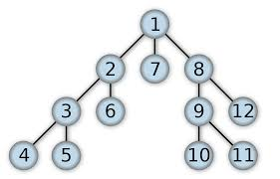
Depth-First Search (DFS)
A DFS traversal of a graph G
Visits all the vertices G
Determines whether G is connected

Slide 57
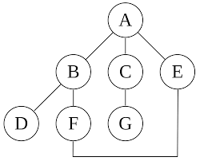
Depth-First Search (DFS)
The DFS of a graph first visits a vertex then recursively visits all the vertices adjacent to that vertex
Graph may contains cycles that lead to an infinite recursion
One needs to keep track of the vertices that have been visited

Slide 58
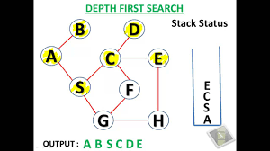
Depth-First Search Algorithm
The search starts from some vertex v and explores as far as possible along each branch before backtracking
After visiting v, the next vertex to be visited is the first unvisited neighbor of v
If v has no unvisited neighbor, backtrack to the vertex from which we reached v

Slide 59
Depth-First Search Example
First visit 0, then visit its neighbor 1

Slide 60
Depth-First Search Example
1 has three neighbors (0, 2, and 4)
0 has already been visited, so lets visit 2

Slide 61
Depth-First Search Example
2 has three neighbors (0, 1, and 3)
0 and 1 have already been visited, so lets visit 3
Order is 0, 1, 2, 3

Slide 62
Depth-First Search Example
Since all the neighbors of 3 have been visited, backtrack to 2 and then 1
0 and 2 have already been visited, so lets visit 4
Backtrack to 1 and then to 0
The search is search ends

Slide 63
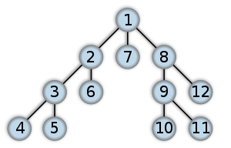
Depth-First Search Order
DFS Order (1 ,2, 3, 4, 5, 6, 7, 8, 9, 10, 11, 12)

Slide 64
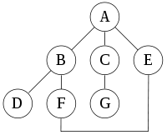
Another Depth-First Search Example
Search order (assuming that the left edges are chosen before right edges)
A, B, D, F, E, C, G

Slide 65
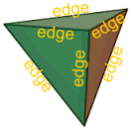
Types of Edges
Discovery
Edges used to discover new vertices
Back
Edges that lead to already discovered vertices

Slide 66
DFS Example
A
B
C
D
A
B
C
D
E
F
G
H
E
F
G
H
I
J
K
L
I
J
K
L
M
N
O
P
M
N
O
P
Start with (A,E)
A, E, I, M, N, K, O, P, L, H, D, C, B, F
Backtrack to C and then visit G and J
Discovery edge
Back edge

Slide 67
DFS Example (1)
A
unexplored vertex
A
A
visited vertex
B
D
E
unexplored edge
discovery edge
C
back edge
A
A
B
D
E
B
D
E
C
C

Slide 68
DFS Example (2)
A
A
B
D
E
B
D
E
C
C
A
A
B
D
E
B
D
E
C
C

Slide 69
Depth-First Implementation
Parent of Seattle is Chicago, parent of San Francisco is Seattle, parent of Los Angeles is Denver, parent of Denver is Chicago, parent of Kansas City is Chicago, parent of Boston is Chicago, parent of New York is Chicago, parent of Atlanta is Kansas City, parent of Miami is Atlanta, parent of Dallas is Kansas City, parent of Houston is Atlanta
DFS order:
Chicago Seattle San Francisco Los Angeles Denver Kansas City New York Boston Atlanta Miami Houston Dallas

Slide 70
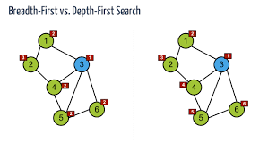
DFS Algorithm (1)
For graph G
Begin with a specific vertex, s for graph G
Visit and paint this vertex
Label it the current vertex, u
Traverse G by considering edge (u,v) incident to the current vertex u
If the edge (u,v) leads to an already visited vertex (painted) then return to u
Otherwise paint v as the current vertex and label it u and recur this step

Slide 71
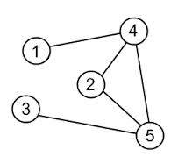
DFS Algorithm (2)
Eventually one will experience a “dead end”
A current vertex u such that all edges incident on u lead to vertices that have already been visited
Backtrack along the edge to a previously visited vertex v and this process
Continue backtracking until the original vertex s is reached

Slide 72
DFS Algorithm
Algorithm DFS(G, v)
Input graph G and a start vertex v of G
Output labeling of the edges of G in the connected component of v as discovery edges and back edges
label v as visited
for all e ∈ G.incidentEdges(v)
if edge e is unvisited
w ←G.opposite(v,e)
if vertex w is unexplored
label e as a discovery edge
recursively call DFS(G,w)
else
label e as a back edge
13.1

Slide 73
Properties of DFS
Property 1
DFS(G, v) visits all the vertices and edges in the connected component of v
Property 2
The discovery edges labeled by DFS(G, v) form a spanning tree of the connected component of v
A
B
D
E
C

Slide 74
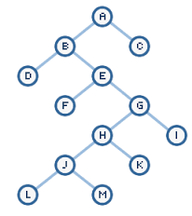
More Properties of Depth-First Search Algorithm
DFS on a graph with n vertices and m edges takes O(n + m ) time
DFS can be further extended to solve other graph problems
Testing whether G is connected
Computing a spanning tree of G, if G is connected
Computing the connected components of G
Computing a path between two given vertices of G, if it exists
Computing a cycle in G, or reporting that G has no cycles

Slide 75
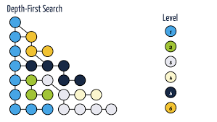
Analysis of DFS
Setting/getting a vertex/edge label takes O(1) time
Each vertex is labeled twice
once as UNEXPLORED
once as VISITED
Each edge is labeled twice
once as UNEXPLORED
once as DISCOVERY or BACK
Method incidentEdges is called once for each vertex
DFS runs in O(n + m) time provided the graph is represented by the adjacency list structure
Recall that Σ_{v} deg(v) = 2m

Slide 76
Path Finding
We can specialize the DFS algorithm to find a path between two given vertices u and z using the template method pattern
We call DFS(G, u) with u as the start vertex
We use a stack S to keep track of the path between the start vertex and the current vertex
As soon as destination vertex z is encountered, we return the path as the contents of the stack
Algorithm pathDFS(G, v, z)
v.setLabel(VISITED)
S.push(v)
if v = z
return S.elements()
for all e ∈ v.incidentEdges()
if e.getLabel() = UNEXPLORED
w ← e.opposite(v)
if w.getLabel() = UNEXPLORED
e.setLabel(DISCOVERY)
S.push(e)
pathDFS(G, w, z)
S.pop(e)
else
e.setLabel(BACK)
S.pop(v)

Slide 77
Cycle Finding
We can specialize the DFS algorithm to find a simple cycle using the template method pattern
We use a stack S to keep track of the path between the start vertex and the current vertex
As soon as a back edge (v, w) is encountered, we return the cycle as the portion of the stack from the top to vertex w
Algorithm cycleDFS(G, v, z)
v.setLabel(VISITED)
S.push(v)
for all e ∈ v.incidentEdges()
if e.getLabel() = UNEXPLORED
w ← e.opposite(v)
S.push(e)
if w.getLabel() = UNEXPLORED
e.setLabel(DISCOVERY)
pathDFS(G, w, z)
S.pop(e)
else
T ← new empty stack
repeat
o ← S.pop()
T.push(o)
until o = w
return T.elements()
S.pop(v)

Slide 78
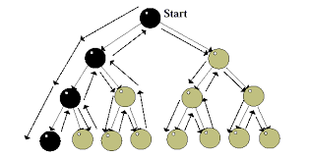
DFS Time Complexity
The time complexity of the DFS algorithm is O(|E| + |V| ) where |E| is the number of edges and |V| is the number of vertices since each edge and vertex is visited only once

